Slide 1

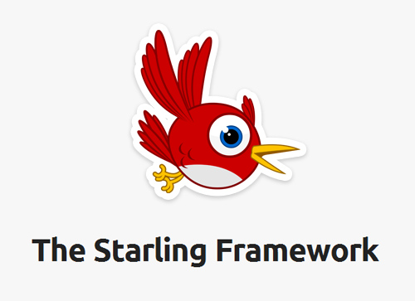
Starling Framework
Michael
WA : 08984838516
Line: alvabethistmic
www.origamingmedia.com/landing

Slide 2

Apa itu Starling Framework?

Slide 3
Mengapa menggunakan starling framework?

Slide 4
Prerequest
Kemampuan logika yang baik
Kemampuan pemrograman dasar
OOP dasar
Bahasa pemrograman ActionScript 3 (AS3)
HOBI dan jangan bosan.

Slide 5
Tools dan library

Slide 6



1. IDE (Integrated development environment )
FlashDevelop (Free)
http://www.flashdevelop.org/
Adobe FlashBuilder (Bayar)
http://www.adobe.com/products/flash-builder.html
IntelliJ IDEA (Free) Khusus Adobe (Bayar)
https://www.jetbrains.com/idea/

Slide 7
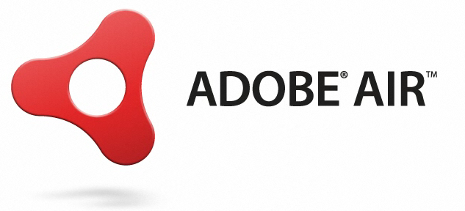
2. SDK (Software development kit)
AIR SDK (http://www.adobe.com/devnet/air/air-sdk-download.html)
Air Runtime (http://www.adobe.com/products/air/runtime-distribution3.html)
Starling Framework v.2.0 ke atas
(https://github.com/Gamua/Starling-Framework)
(http://gamua.com/starling/download/)

Slide 8

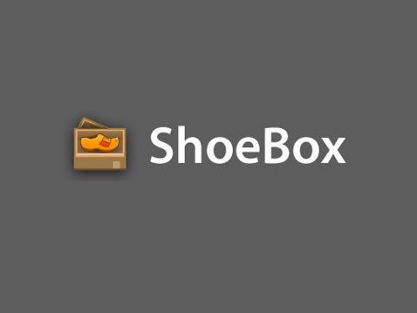
3. TexturePacker
TexturePacker (Bayar) (https://www.codeandweb.com/texturepacker)
ShoeBox (Free) (http://renderhjs.net/shoebox/)

Slide 9
4. BITMAT Font Generator
Littera (Free) (http://kvazars.com/littera/)
BM Font (Free) (http://www.angelcode.com/products/bmfont/)

Slide 10

5. 2d Animation
Spine (Bayar) (http://esotericsoftware.com/)
DragonBones (Free) (http://dragonbones.com/en/index.html#.WAjcWOB97Dc)

Slide 12
6. Library
Feathers (https://github.com/BowlerHatLLC/feathers/) ,(http://feathersui.com/)
Greensock (https://greensock.com/)
PD Particle System
Treefortress SoundManager (https://github.com/treefortress/SoundAS)

Slide 13
Link yang membantu
http://forum.starling-framework.org/
http://wiki.starling-framework.org/

Slide 14
Beberapa game starling framework yang luar biasa

Slide 15

ARMAJET

Slide 16
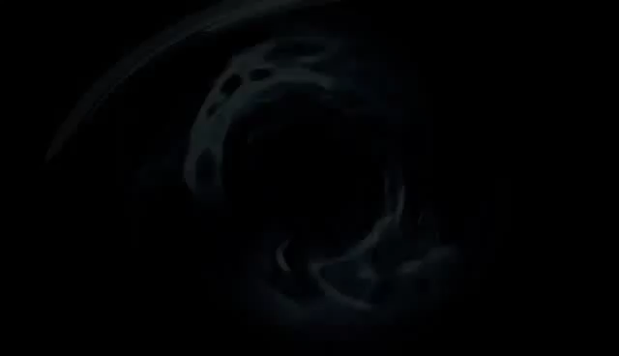
NCIS – HIDden crime (hidden object)

Slide 17

Home Makeover 3

